Slide 1
ANALYSIS OF SEQUENTIAL CIRCUIT LOGIC DIAGRAM
J.SHEIK SHABJAN M.Sc., M.Phil., SET
ASSISTANT PROFESSOR
DEPARTMENT OF ELECTRONICS
St. JOSEPH’S COLLEGE (Autonomous),
TRICHY

Slide 2
SYNCHRONOUS SEQUENTIAL CIRCUIT WITH A T FLIP FLOP
Let explore the behavior of the circuit in fig by developing a timing diagram, state table and state diagram
X = 01101000

Slide 3
T FLIP FLOP

Slide 4
The logic equations
for the example are
The input sequence is
Assume starting state is y = 0

Slide 5
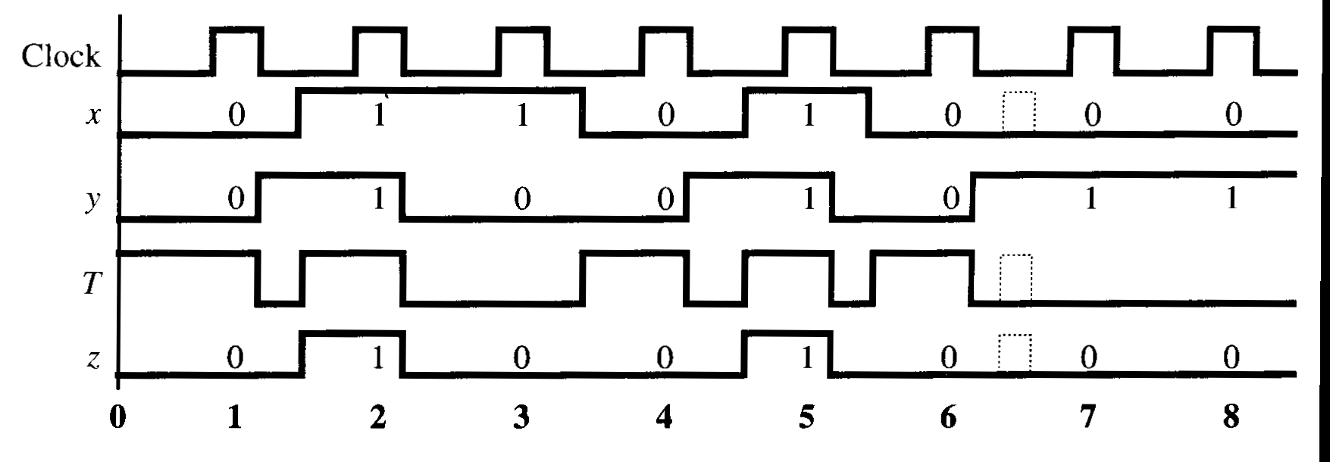
Timing diagram
Notice that all the input transitions are not synchronized with the clock pulse.

Slide 6
State diagram and state table

Slide 7
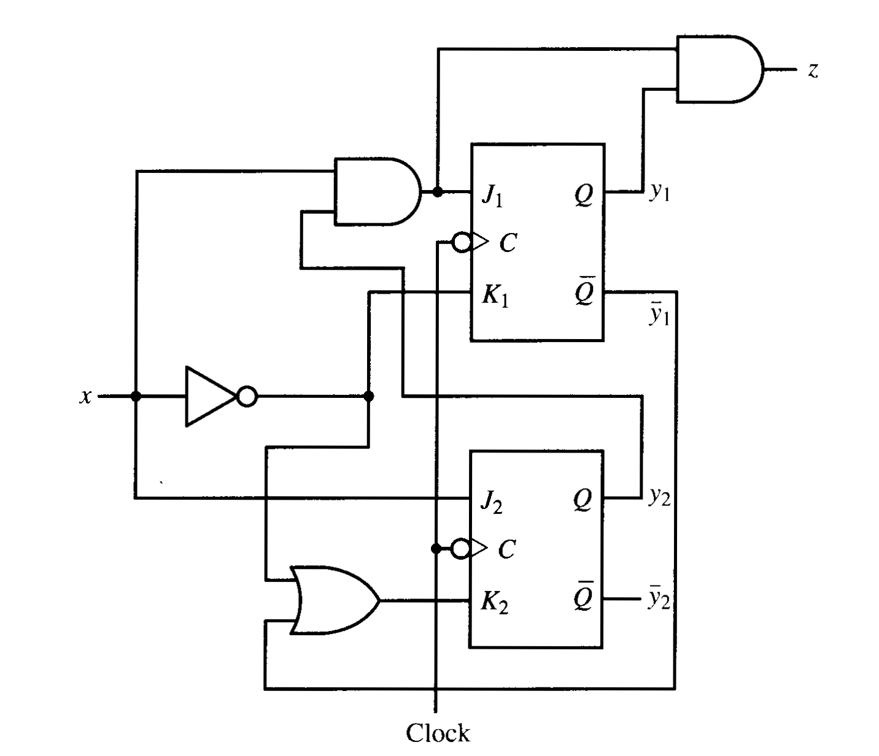
SYNCHRONOUS SEQUENTIAL CIRCUIT WITH JK FLIP FLOPS
X = 0011110

Slide 8
JK FLIP FLOP

Slide 9
The logic equations
for the example are
The input sequence is
Assume starting state is
The output sequence is
Z = 0000010
9

Slide 10
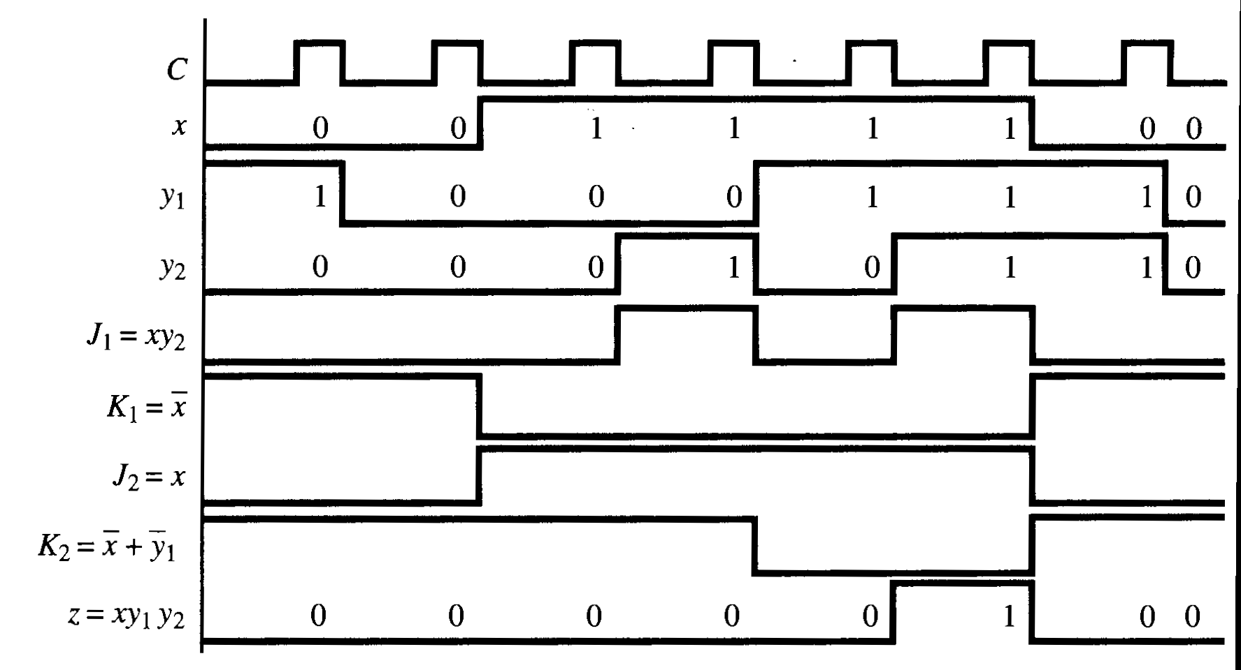
Timing diagram

Slide 11
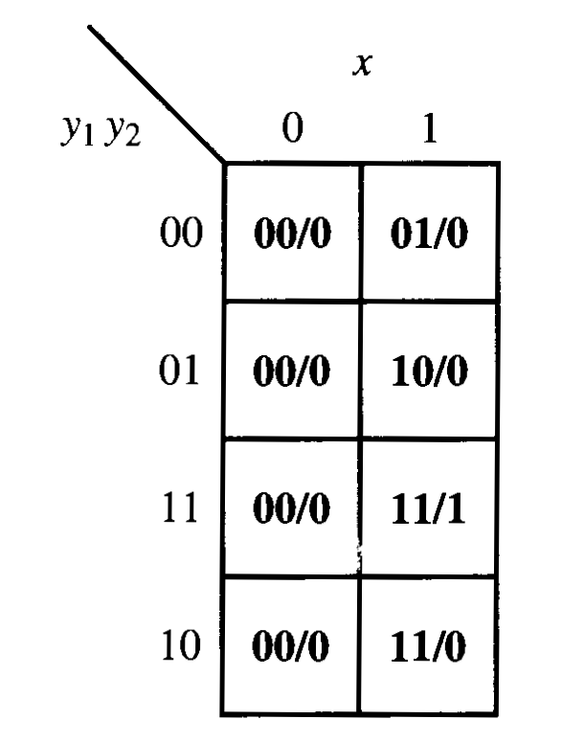
State table

Slide 12
SYNCHRONOUS SEQUENTIAL CIRCUIT SYNTHESIS

Slide 13
TYPES OF SEQUENTIAL CIRCUITS
Completely specified circuit
Incompletely specified circuit

Slide 14
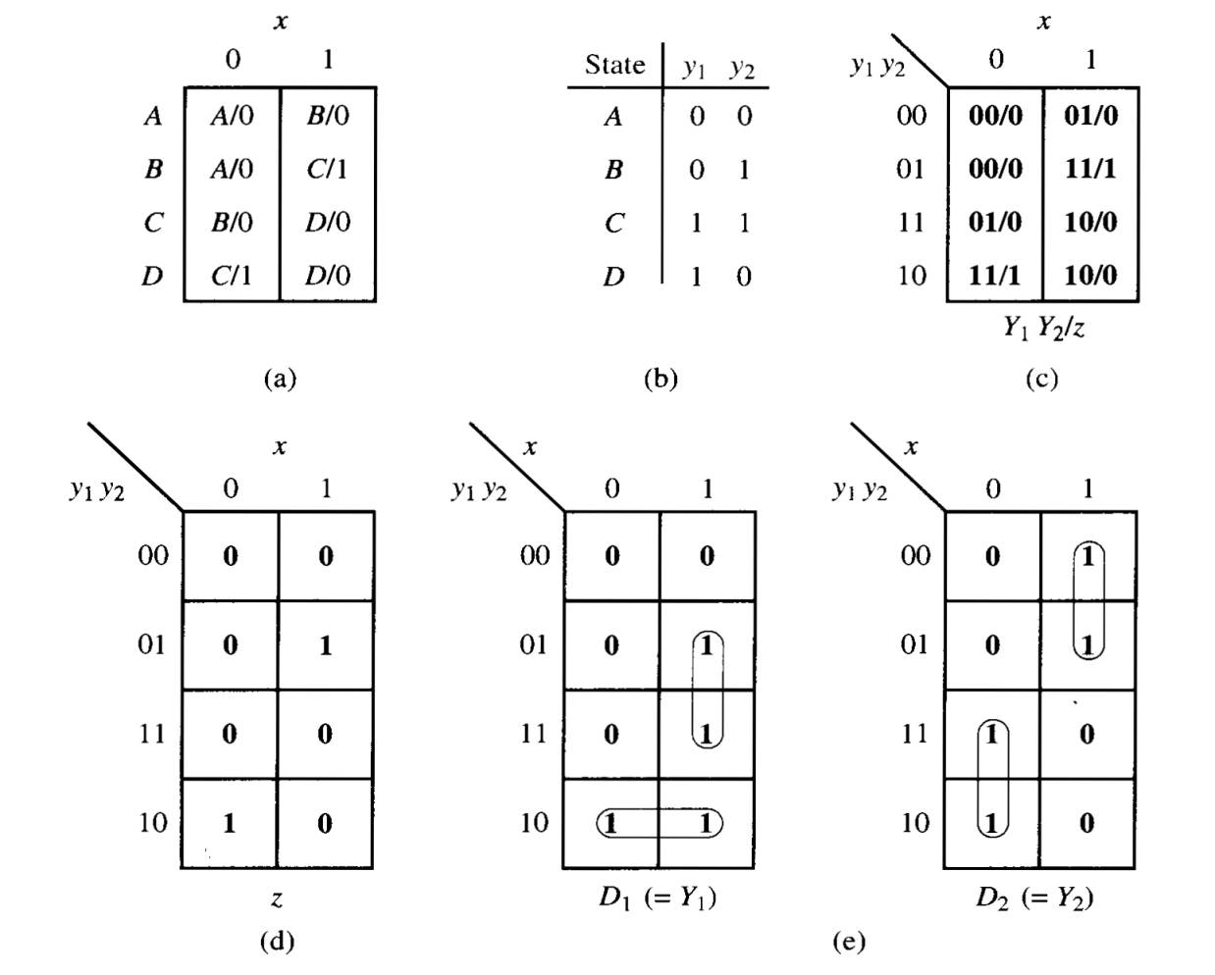
Synthesis Procedure
Let us find a clocked D flip flop realization for the sequential circuit defined in the state table

Slide 15
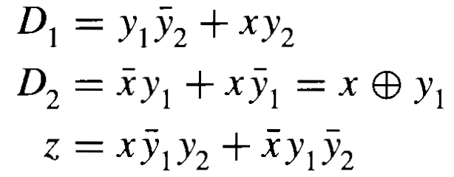

Slide 16
